Slide 1
Migrating your local database to Azure SQL DB
Marcos Freccia

Slide 2







Thank you to our AWESOME sponsors!

Slide 3

Marcos Freccia
SQL Server DBA at Zalando SE
@sqlfreccia
sqlfreccia@outlook.com
http://marcosfreccia.wordpress.com
Data Platform MVP
MCSA DBA & DEV SQL Server 2016 – Charter
MCSE Data Management and Analytics SQL Server 2016 – Charter
SQL Server DBA for 8 years
Originally from Brazil, now living in Berlin, Germany

Slide 4
Agenda
Which tools are we going to use in this session?
Azure SQL Database DTU Calculator.
Database Transaction Unit (DTU). Why this is important?
Demos

Slide 5

Which tools are we going to use in this session?
Management Studio is your friend
Always install the latest updates!
https://docs.microsoft.com/en-us/sql/ssms/download-sql-server-management-studio-ssms
Microsoft Azure (off course)
Azure CLI or Cloud Shell
Python 3+
http://www.python.org/downloads
Database Migration Assistance – DMA
https://www.microsoft.com/en-us/download/details.aspx?id=53595
dbatools
https://dbatools.io/
Notes:
https://github.com/Microsoft/sql-server-samples/releases/tag/wide-world-importers-v1.0

Slide 6
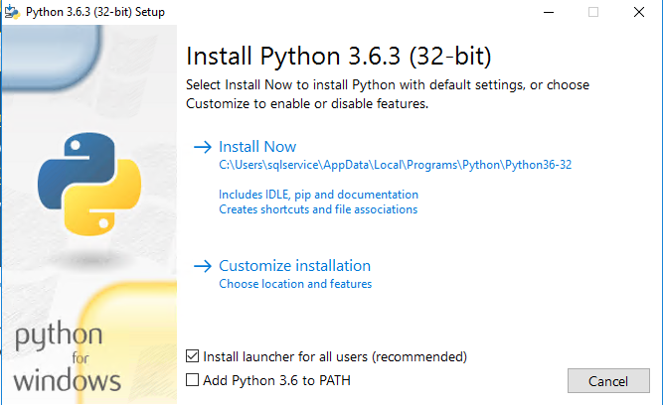
Setup Python and MSSQL Scripter
https://www.python.org

Slide 7
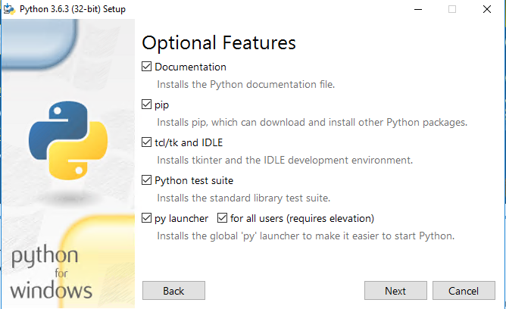
Setup Python and MSSQL Scripter
https://www.python.org

Slide 8
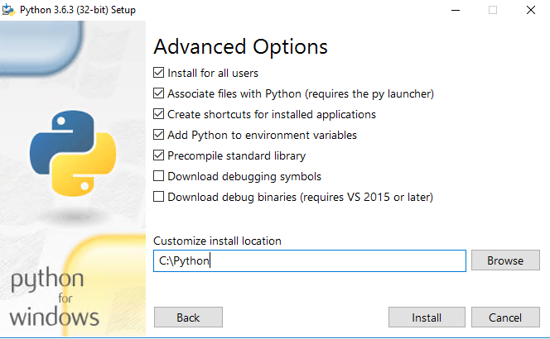
Setup Python and MSSQL Scripter
https://www.python.org

Slide 9
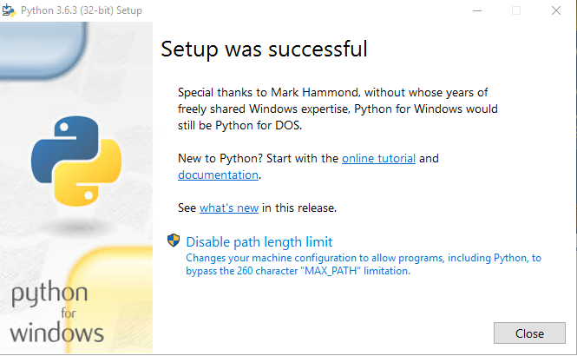
Setup Python and MSSQL Scripter
https://www.python.org

Slide 10
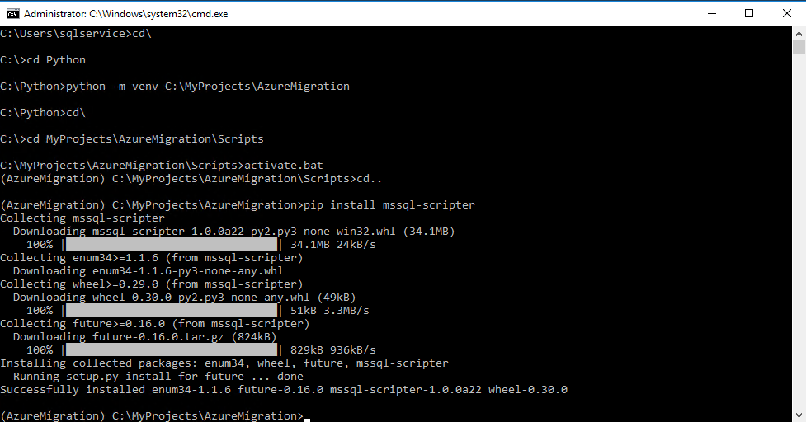
Setup Python and MSSQL Scripter
https://github.com/Microsoft/mssql-scripter

Slide 11
Setup dbatools
Open Powershell as Administrator
Type Install-Module dbatools and execute

Slide 12
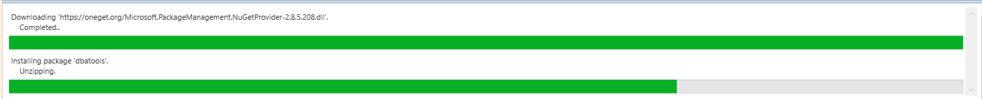
Setup dbatools
Open Powershell as Administrator
Type Install-Module dbatools and execute

Slide 13
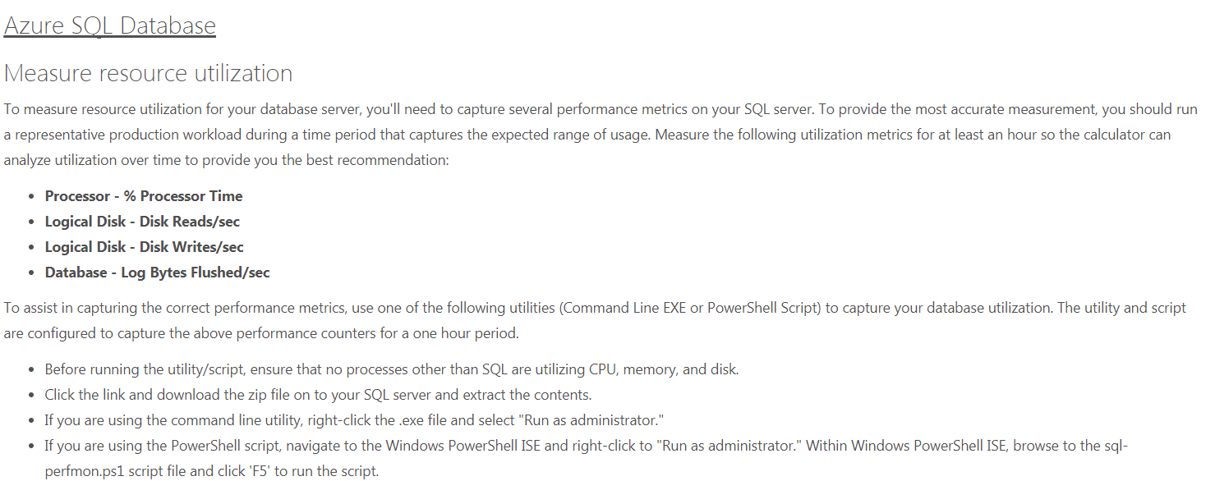
Database Transaction Calculator?
http://dtucalculator.azurewebsites.net/

Slide 14
Database Transaction Calculator?
http://dtucalculator.azurewebsites.net/

Slide 15
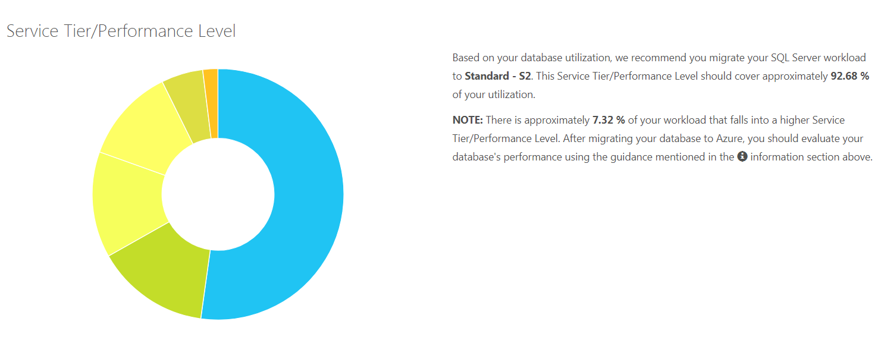
Database Transaction Calculator?
http://dtucalculator.azurewebsites.net/

Slide 16
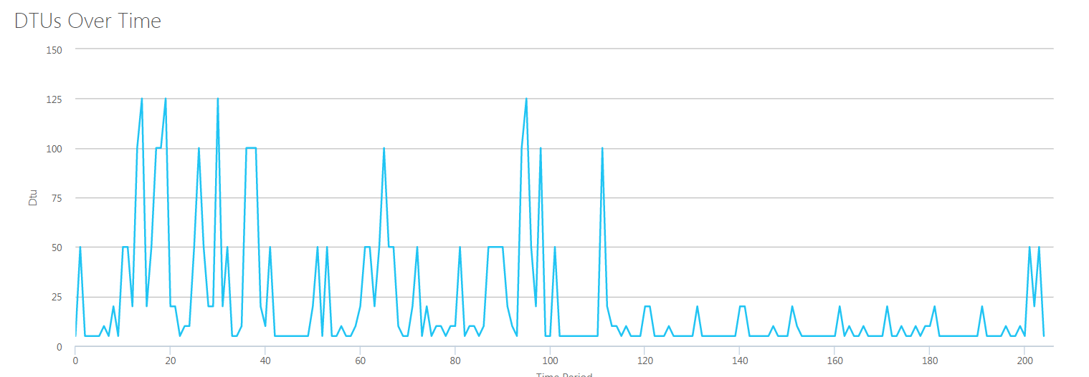
Database Transaction Calculator?
http://dtucalculator.azurewebsites.net/

Slide 17
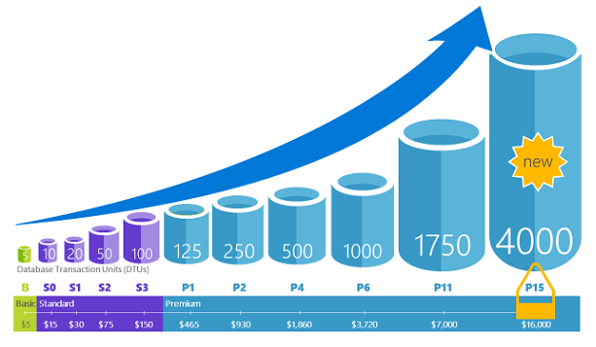
Database Transaction Unit (DTU). Why this is important?
https://docs.microsoft.com/en-us/azure/sql-database/sql-database-what-is-a-dtu

Slide 18
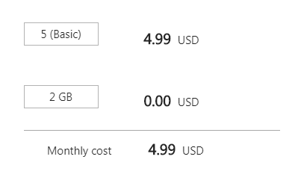
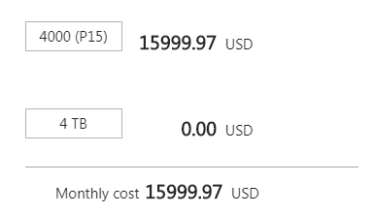
Database Transaction Unit (DTU). Why this is important?
https://docs.microsoft.com/en-us/azure/sql-database/sql-database-what-is-a-dtu

Slide 19
Demo

Slide 20
Looking for more resources?
https://docs.microsoft.com/en-us/azure/sql-database/sql-database-migrate-your-sql-server-database
https://docs.microsoft.com/en-us/cli/azure/install-azure-cli?view=azure-cli-latest
https://blogs.msdn.microsoft.com/datamigration/dma/
https://blogs.msdn.microsoft.com/sqlcat/2016/10/20/migrating-from-sql-server-to-azure-sql-database-using-bacpac-files/
https://github.com/Microsoft/sql-server-samples
https://azure.microsoft.com/en-us/pricing/details/sql-database/

Slide 21
Thank you!
Hvala vam!
https://goo.gl/CDY5jD
http://marcosfreccia.wordpress.com
https://github.com/marcosfreccia/sql-saturday-687-slovenia sqlfreccia@outlook.com

